Slide 1
SIT374: Project Management
Lecture 9 (Chapter 8 & 12):
Project Procurement and Quality

Slide 2
Procurement
Acquiring goods and services from an outside source.
Procurement/Outsourcing/Purchasing
Suppliers, vendors, contractors, subcontractors, or sellers
Why?
Skills and expertise
Reduce cost and increase flexibility
Focus more on business
Accountability
When not? “What you want to handle in-house is the stuff that gives you an edge over your competition..”

Slide 3
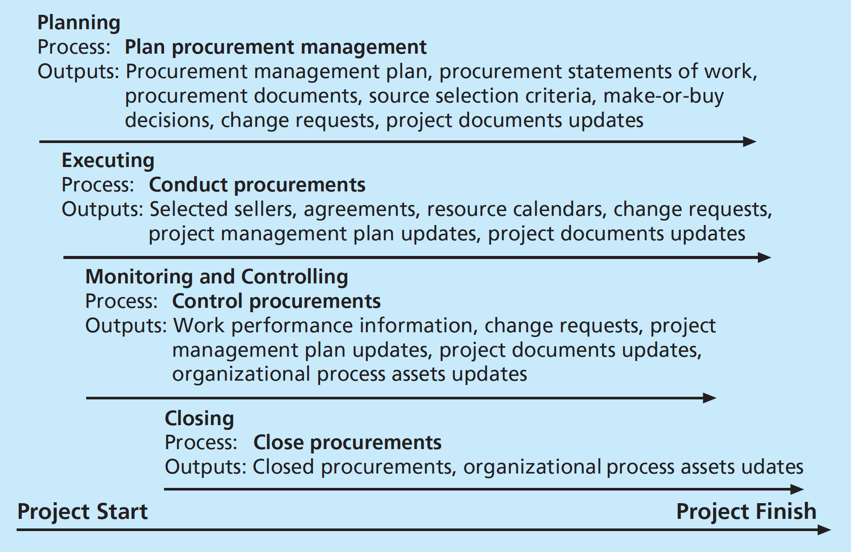
Procurement Management
Inputs:
PMP,
Requirements Document,
Risk Register,
Activity Resources,
Project Schedule,
Activity Cost Estimate,
Stakeholder Register

Slide 4
1. Plan procurements
Planning procurements involve deciding whether to procure, how to procure, what to procure, how much to procure and when to procure.
An important output includes the make-or-buy decision, procurement management plan, statement of work, procurement documents (request for proposals or quotes).

Slide 5
Tools and Techniques for Procurement Planning
Make-or-Buy Analysis: Compare internal cost vs cost of outsourcing. If the supplier’s estimate is lower than he internal estimates, company should consider outsourcing, user support services
Expert Judgment: from insider and outside (potential suppliers), the company,
Market Research: Project team need to choose from the right supplier carefully.

Slide 6
Statement of work (SOW) and contract
A contract is a mutually binding agreement that obligates the seller to provide the specified products or services and obligates the buyer to pay for them.
Statement of work (SOW) is a description of work required for the procurement.
Contract Statement of Work is a document that describes only the work required for a particular contract. A contract SOW should be clear, concise, and as complete as possible.
If a SOW should describe all the work in sufficient details for the prospective supplier to determine if they can provide the required goods and services and to know the price as well.
Notes:
The Statement of work (SOW) is the description of the work required for procurement.
If SOW is used to describe only the work required for a particular contract, it is called a contract statement of work.

Slide 7
Contract Type
Key categories: fixed price or lump sum, cost reimbursable, time and material, and unit pricing.
Fixed price: involve a fixed total price for a well-defined product or service.
Buyer has little risk, seller pads the estimate to reduce the risk; such that the price is still competitive.
May include incentives for meeting or exceeding selected project deliverables.
Variations include:
Firm-fixed-price (FFP)- least amount of risk for the buyer
Fixed-price with incentive fee (FPIF)
FP with economic adjustments contract (FP-EPA)- pre-defined final adjustments to the contract price due to changes in the condition like inflation.
Notes:
FP-EPA: Protects both buyer and seller from external conditions

Slide 8
Contract Type
Cost-reimbursable contracts: involves payment to the supplier for direct and indirect actual costs.
Include, fee such as profit percentage or incentives for meeting or exceeding selected projects.
The buyer absorbs more of the risk (than fixed price contracts)
Different variations of Cost reimbursable contract:
Cost plus incentive fee (CPIF) contract: Buyer pays the supplier for allowable performance costs along with predetermines fee and incentive bonus.
Cost Plus fixed fee (CPFF): The buyer pays the supplier for allowable performance costs plus fixed fee payment that is usually based on a percentage of estimated costs.
Notes:
Direct costs: related to producing a project’s products and services (salaries), Indirect costs – not directly related to the products (cost of providing work place, electricity)
Cost reimbursable contracts are used when projects include new technologies

Slide 9
Contract Type
Cost plus award fee (CPAF) contract: The buyer pays the supplier for allowable performance costs plus an award fee based on the satisfaction of subjective performance criteria.
Cost plus percentage of costs (CPPC) contract: The buyer pays the supplier for allowable performance costs along with a predetermines percentage based on total costs. (For Buyers –least preferred as there is no incentive for the suppliers to decrease the costs, instead increase it).
Time and Material (T&M) contracts: hybrid of fixed-price and cost-reimbursable contracts.
The consultant would send an invoice each week or month which would list the material fee, number of hours worked and description of work produced.
This type of contract is used when work cannot be specified and total costs cannot be estimated in a contract.

Slide 10
Unit pricing
Unit Pricing: can be used in various types of contracts to require the buyer to pay the supplier a predetermined amount per unit of product or service.
The total value of the contract is a function of quantities needed to complete the work.
These type of contracts often involve volume discounts
Notes:
Purchase of 10 units of hardware where cost of each unit is known.

Slide 11
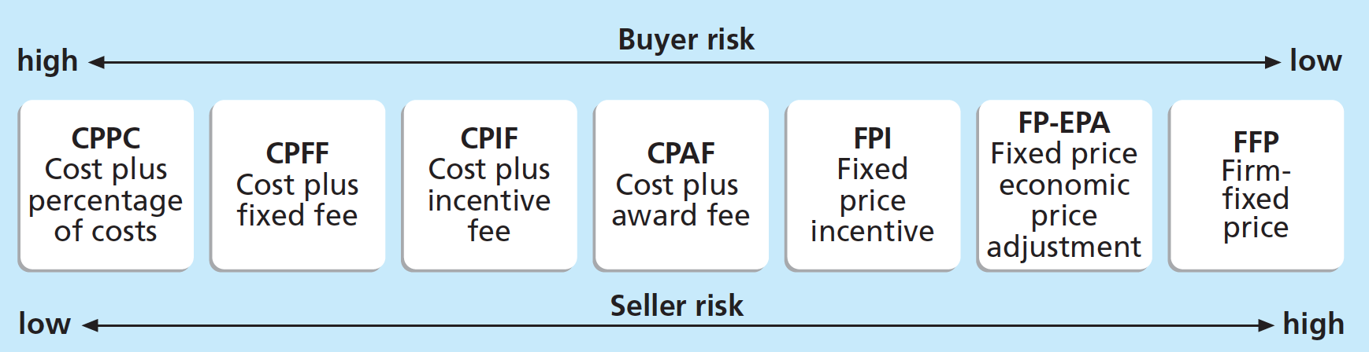
Contract type vs Risk

Slide 12
Procurement Management Plan
Guidelines on contract type and other documents
Roles and responsibilities of the project team and related departments, such as the purchasing or legal department
Processes for coordinating procurement decisions with other project areas, such as scheduling and performance reporting
Constraints and assumptions related to purchases and acquisitions
Risk mitigation strategies for purchases and acquisitions, such as insurance contracts and bonds
Procurement metrics to assist in evaluating sellers and managing contracts
Sample Procurement Management Plan

Slide 13
Procurement Documents
Request for proposal: is a document used to solicit proposals from prospective suppliers. A proposal is a document prepared by a seller when there are different approaches for meeting buyer needs.
The organization want to solve a problem, it issues and RFP to the suppliers who then respond to the proposals.
Request for Quote: is a document used to solicit quotes or bids from prospective suppliers. A bid/tender/quote, is a document prepared by sellers to provide pricing for standard items that the buyer has clearly defined. Use this when you have a specific item to purchase.

Slide 14
Request for Proposal Template
Purpose of RFP
Organization Background
Basic Requirement
Hardware and Software Environment
Description of RFP Process
Statement of Work and Schedule Information
Possible Appendices
Current System Overview
System Requirements
Sample Contract

Slide 15
2. CONDUCT PROCUREMENTS
Plan and prepare documents and selection criteria
Advertise to potential sellers
Supplier conference (pre bid conference) – meeting of prospective suppliers prior to the proposals or bids. Helps everyone to understand the desired product or service required by the supplier.
Quotes or proposals received: After receiving the proposals or bids the suppliers can select the supplier or decide to cancel the procurement.
Source selection: Formal evaluation sheet should be used by the buyers. Following this, a detailed process for proposal evaluation is conducted (Weighted Score Model is used). Several stakeholders (technical, management, cost team) are involved in selecting the supplier.
Contract negotiations happened in the source selection process. Sellers on the short list are asked to prepare the Best and Final Offer (BAFO)
6. Contract: The final output of the process is the contract
Notes:
Selection criteria for source selection: this criteria is used to rate or score the proposals. Weightage is usually assigned to each criteria to indicate its importance. Some criteria are: technical approach, management approach, past performance, price.
RFP usually requires the bidder to list other similar projects they have worked on and provide customer reference for those projects as well.

Slide 16
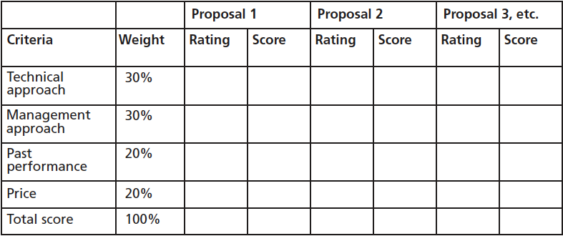
Sample evaluation on proposal
Notes:
Selection criteria for source selection: this criteria is used to rate or score the proposals. Weightage is usually assigned to each criteria to indicate its importance. Some criteria are: technical approach, management approach, past performance, price.
RFP usually requires the bidder to list other similar projects they have worked on and provide customer reference for those projects as well.

Slide 17
3. CONTROL PROCUREMENTS
Controlling procurements ensures that the sellers performance meets contractual requirements.
Contractual relationship is a legal, so team members must understand the potential legal problems that might arise while carrying out the project.
Change management process
Constructive change orders These are oral or written acts or omissions by someone with actual or apparent authority that can be construed to have the same effect as the written change order.
if the buyer wanted to change requirements in the contract…the seller can then bill the buyer for the new requirements

Slide 18
4. Contract CLOSURE
Determine if all work required in each contract was completed correctly and satisfactorily and resolution of any open items.
Procurement audits are often done during contract closure to identify lessons learned in the entire procurement process.
The buyer provides the seller with formal written notice that the contract has been completed.

Slide 19
Activity 1
You are the IT Procurement Manager in a healthcare organization that is initiating a project to implement an electronic health records (EHR) system. The project aims to improve patient care and operational efficiency but must adhere to strict healthcare regulations and data privacy standards, including HIPAA. The organization has a limited budget and a deadline of one year to go live with the system.
Three vendors have made it to the final round of consideration. Vendor X offers an EHR system with advanced analytics capabilities but requires a longer implementation time. Vendor Y proposes a cost-effective, user-friendly system but lacks advanced analytics. Vendor Z presents a solution that meets the middle ground in terms of functionality and cost but has had past issues with customer support.
Given the critical importance of patient data security, compliance with healthcare regulations, and the need for a smooth implementation within the deadline and budget, how would you proceed with the vendor selection?

Slide 20
Project Quality Management…

Slide 21
Quality Defined
The degree to which product characteristics fulfills requirements. The customer ultimately decides if quality is acceptable
Can be subjective
You may accept Windows crashing
BUT what about your car crashing?
Quality management ensures project satisfies the needs of the stakeholders

Slide 22
Quality Defined
Quality is based on the conformance to requirements and fitness to use.
Conformance to requirements: project’s processes and products meet written specification.
Fitness to use: products can be used as it was intended
Quality management: is to ensure that the project will satisfy the needs for which the project is undertaken.

Slide 23
Processes
Planning
QA
QC
Three part process
Planning: includes identifying which quality requirements and standards are relevant to the project and how to satisfy them.
Assurance (QA): involves periodically overall project performance to ensure that the project will satisfy the relevant quality standard.
Control (QC): involves monitoring the specific project results to ensure that they comply with the relevant quality standards while identifying ways to improve the quality standards.
Tools used : Quality control charts, statistical sampling.

Slide 24
1. Planning
Planning
QA
QC
Anticipate situations and prepare actions to bring about desired outcomes
In Quality Speak = defect prevention
How?
Select proper materials?
Training people in quality
Create processes to enable desired outcomes
Remember our cooking analogy?

Slide 25
Planning Techniques
Planning
QA
QC
Design of experiments
Identify variables of most influence
Create processes to address each variable
What variables?
Triple constraints
Stakeholder needs
How?
Recall EVM - Earned Value Management?
What about CPM - Critical Path Method?

Slide 26
Important scope aspects of IT projects
Functionality: Degree to which the system performs its intended function.
Features: are the system’s special characteristics that appeal to users. Mandatory functions and features of the system must be identified.
System Output: are the screens and reports the system generates.
Performance: addresses how well a product and service performs the customer’s intended use.
Reliability: is the ability of a product or service to perform as expected under normal conditions.
Maintainability: ease of performing maintenance on a product.
Notes:
Performance Criteria includes: volume of data and transactions the system is capable to handle ; No. of users the system can handle ; No. of simultaneous uses the system can handle; response time of the system; reliability of the system.

Slide 27
2. Quality Assurance (QA)
Planning
QA
QC
Activities undertaken to satisfy requirements of project (i.e., satisfy quality measures)
Benchmarking comparing specific project practices or product characteristics to those of other projects or products
Quality audit a structured review of specific quality management activities that help identify lessons learned and that could improve performance on current or future projects
Can be done in-house or third party with expertise in a specific area. Can be scheduled or random.

Slide 28
3. Quality Control (QC)
Planning
QA
QC
Has more work during execution than planning compared to previously discussed knowledge areas
Activities include
Acceptance decisions – when to accept or reject a product/service
Rework – if a product is rejected, what are the necessary actions to bring it back to compliance
Process adjustments – how to prevent this to happen in the future
Many tools available
Notes:
If the deliverables are accepted, they are validate deliverables. If the project stakeholder rejects some of the project’s products or service, there will be a rework.
Rework results in requested changes and validated defect repair from corrective and preventive actions.

Slide 29
QC Tools
Pareto chart
Cause and effect diagram
Control chart
Scatter diagram
Check sheet
Histogram
Flow and run charts

Slide 30
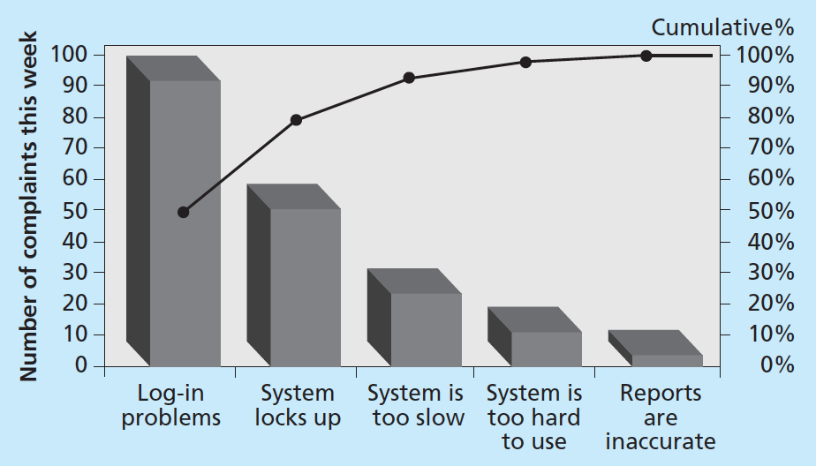
Pareto Analysis
Planning
QA
QC
Identifying key contributors that account for most quality problems
Are histograms representing frequency distribution
Help identify and prioritize problem areas
a.k.a. 80-20 rule

Slide 31
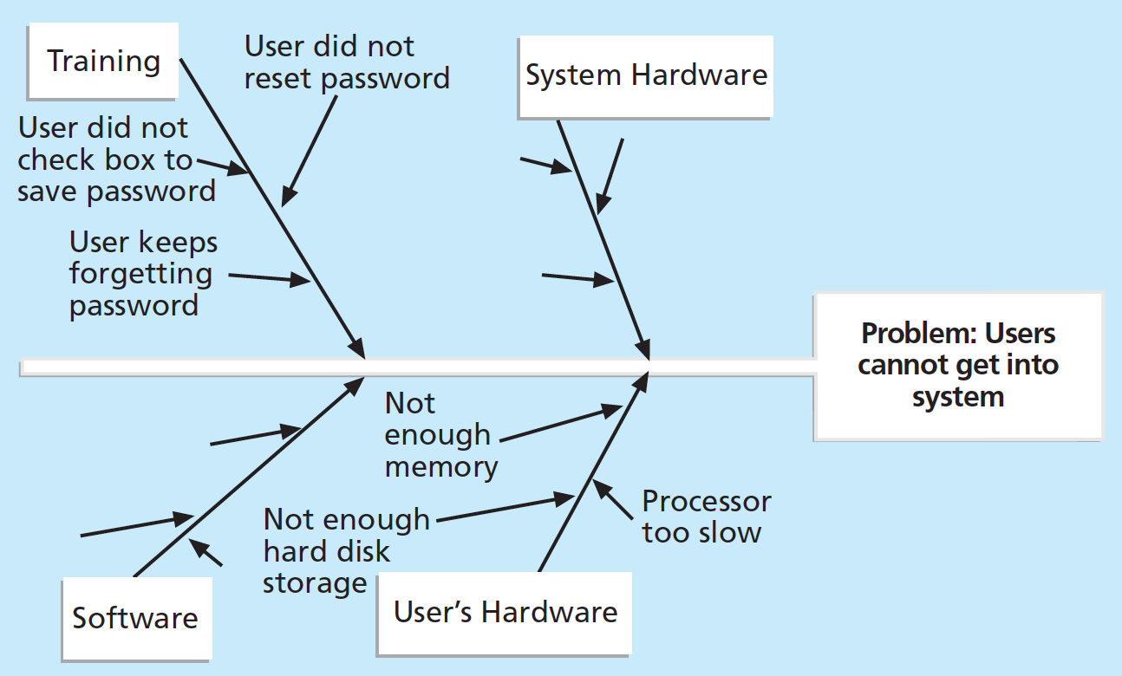
Cause & Effect Diagram
a.k.a Ishikawa’s Diagram

Slide 32
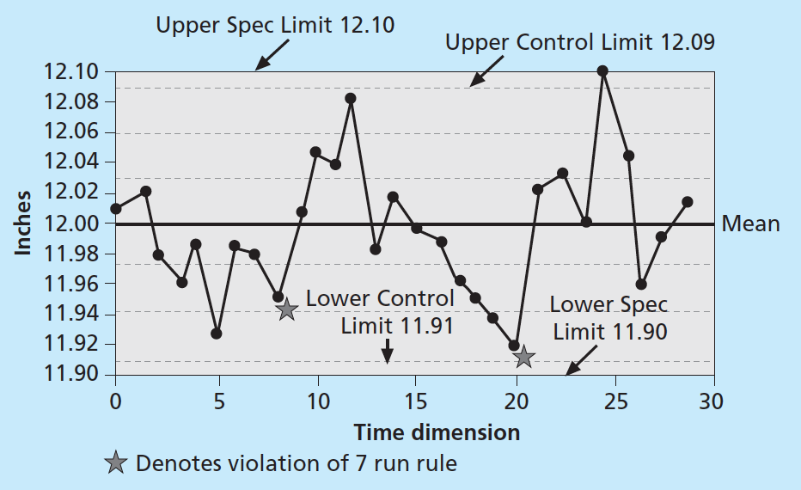
control chart
A graphic display of data that illustrates the results of a process over time. Control charts allow you to determine whether a process is in control or out of control.

Slide 33
Statistical Sampling
Planning
QA
QC
Choosing part of a population of interest for inspection
Method: Simple random vs. stratified random
Need to determine sample size
Example: Sample size = 0.25 X (certainty factor/acceptable error)²
Be sure to consult with an expert when using statistical analysis
Why?

Slide 34
Six-Sigma – 6σ
Planning
QA
QC
A system to achieve, sustain, and maximize business success
Uniquely driven by
Close understanding of customer needs
Disciplined use of facts, data, and statistics
Attention to management of processes
Widely used QC technique
Requires organization-wide commitment

Slide 35
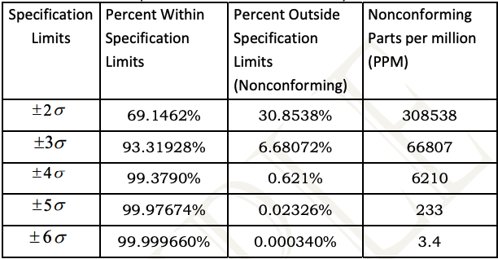
Six-Sigma (cont’d)
Planning
QA
QC
Goal is to minimize deviation
Standard deviation (σ) is key to this technique
No more than 3.4 defects in each million opportunities
Achieved through a closed looped process (a.k.a. DMAIC)
Define the problem, process, and requirements
Measure performance from collect data
Analyze processes to find problem areas
Improve problem areas with solution (Ishikawa Diagram)
Control stability of improvements. Six sigma team plans to pilot test the solutions.

Slide 36
Activity 2
Planning
QA
QC
Imagine you are a Six Sigma Black Belt working as a Quality Manager within an IT firm. The firm is currently developing a new project management software aimed at enhancing productivity and user experience. However, recent quality checks have revealed a higher than acceptable defect rate in the software's core features, including task tracking, resource allocation, and reporting functions.
Senior management is concerned about these quality issues, as they could lead to significant customer dissatisfaction and impact the company's reputation. They have tasked you with implementing a Six Sigma project to reduce the defect rate and improve the overall quality of the software.
How would you clearly define the problem in terms of Six Sigma? What specific goals would you set for this project to align with Six Sigma's quality standards?

Slide 37
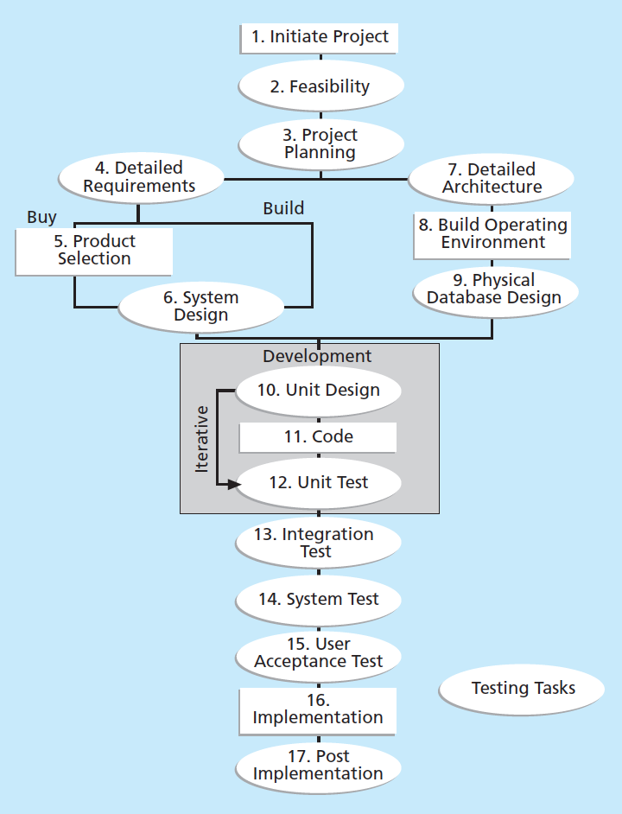
Testing
Software Defect: anything that must be changed before the delivery of the program.
Programs are complex and 100% testing is not possible. Programmers must ensure that they produce error free code.
Types of testing: Unit Testing, Integration Testing, System testing, User Acceptance Testing.

Slide 38
Improving IT project quality – cost of quality
Cost of Quality is the sum of
Conformance costs: delivering the product that meets requirements and fitness for use. E.g.: cost of developing the quality plans, cost of testing
Non-conformance costs: taking responsibility of failures or not meeting the quality expectations.
Types of costs related to quality
Prevention cost: The cost of planning and executing a project so that it is error free or within the acceptable error range. Preventive actions – training, detailed study related to quality, quality surveys of suppliers.
Appraisal cost: The cost of evaluating processes and their output to ensure that a project is error-free or within an acceptable error range. E.g: Inspections, testing of products, reporting inspection data.

Slide 39
Cost of Quality
Internal failure cost : A cost incurred to correct an identified defect before the customer received the product. E.g.: rework, charges related to late payment of bills, inventory costs that are direct result of defects, cost of engineering changes related to design error, correcting documentations.
External failure cost: A cost incurred to all errors not detected and corrected before delivery to the customer. E.g.: warranty costs, field service personal training costs, complaint handling
Measurement and test equipment cost: The capital cost of equipment used to perform prevention and appraisal activities.

Slide 40
Summary
Procurement management
What/how/when to procurement
Quality management
What is quality
Quality metrics
Quality assurance and control

Slide 41
What’s next
Project execution, monitoring and control, closing
Review

